Slide 3
What are the reasons for endoscopically tattooing the colon?
Colon tattoos are used to mark lesions for subsequent surgical resection or for later endoscopic resection, or to mark an endoscopic resection site for easy endoscopic follow-up of the resection site.
Alternatives to tattooing include taking an abdominal radiograph with the endoscope tip at the site of the lesion (for surgical location) or placing metal clips near a lesion followed by taking an abdominal radiograph.
However, tattooing is widely considered the best method of marking the colon.

Slide 4
Which lesions should be considered for marking?
obvious colorectal cancers
lesions with suspected cancer
pedunculated adenomas with endoscopic features of cancer or with sufficient size to have a substantial risk of cancer (≥2 cm in size is a reasonable guide),
large flat or sessile lesions removed by piecemeal endoscopic mucosal resection (EMR) or by endoscopic submucosal dissection (ESD)
Tattooing is appropriate for such lesions in all colon locations, except it is not required in the cecum because the cecum itself is a completely reliable landmark

Slide 5
For the cecum and for some ascending colon lesions, a photograph of the lesion with the appendiceal orifice or the ileocecal valve in view serves as an excellent record to guide surgical resection or subsequent endoscopic follow-up.

Slide 6
What types of ink or dye are available?
Carbon black is the only permanent tattoo appropriate for use in the colorectum. Carbon black is available in India ink, but pure carbon black is commercially available and approved by the US Food and Drug Administration in a formulation called Spot (GI Supply).
A new formulation called Spot Ex is 50% darker than the original formulation; it is sold in 5-mL vials and is immediately ready for endoscopic injection .

Slide 7
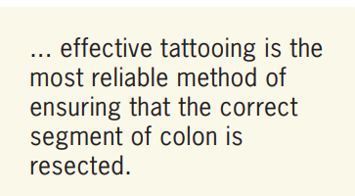

Slide 8
Other substances injected into the submucosa primarily for the purposes of facilitating EMR and ESD,
such as indigo carmine, methylene blue, and indocyanine green, do not leave a permanent tattoo in the colon

Slide 9
How do the dyes compare in terms of safety, efficacy, and ease of use?
Carbon black in the form of India ink is a very effective tattoo. However, because it contains several other substances that are immunologically active, injection of India ink has resulted in complications such as sterile abscess formation, focal peritonitis, and inflammatory pseudotumor, and has precipitated inflammatory bowel disease, although very rarely.

Slide 10
What injection techniques are available, and how are they performed?
During tattooing, the goal is to place the entire injection volume into the submucosal space.
Carbon black, when injected into the submucosa, creates a physical black stain that can be seen endoscopically from the lumen and surgically from the peritoneal cavity.
The most common error made during injection is to insert the needle through the colonic mucosa and simply begin the injection process. This action risks placing the tattoo in the peritoneal cavity or into extracolonic tissue such as the omentum, kidney, stomach, or small intestine.
There are 2 methods to reliably create an injection confined to the submucosa

Slide 11
Technique 1
The most reliable method is to first place a 0.5- to 1.0-mL submucosal bleb of saline (Figure 1). Then, a needle to deliver the tattoo is inserted into the saline bleb, and the tattoo is injected.
This technique will reliably ensure that the tattoo enters only the submucosal space.

Slide 12
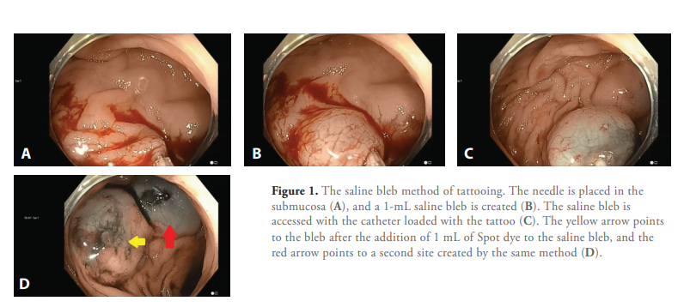

Slide 13
Technique 2
is direct injection of the tattoo into the submucosa (Figure 2).
Expert endoscopists can perform this reliably by approaching the mucosa tangentially (rather than en face), inserting the needle, and lifting the needle toward the center of the lumen.
If the shape of the needle, including the bevel, is visible through the mucosa, the needle tip is reliably in the submucosa. A small injection is made to verify that a submucosal bleb develops, and then the injection is completed. The correct injection volume at each site is 0.75 to 1.0 mL.

Slide 14
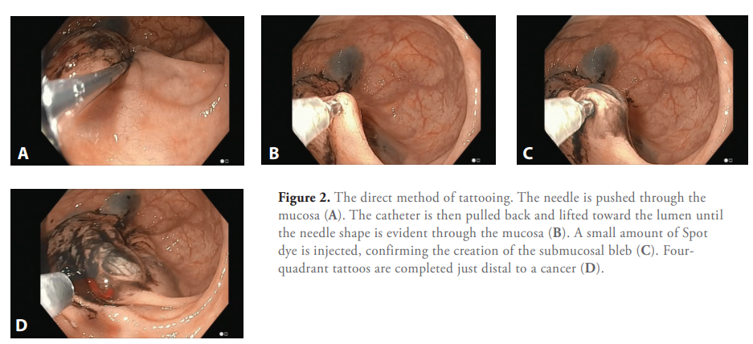

Slide 15
How do the techniques for surgical vs endoscopic marking differ?
For surgical marking, it is best to inject all 4 quadrants of the lumen. Optimally created, the 4 tattoos are opposite each other, nearly touching each other along the circumference of the wall.
When marking for endoscopic follow-up, tattooing only 1 side of the colon wall is sufficient.

Slide 16
What are the benefits and limitations of tattooing in the colon?
Effective tattooing has been shown to reduce operating room time with the result of a significant cost savings.
Furthermore, effective tattooing is the most reliable method of ensuring that the correct segment of colon is resected.
Visualization of the tattoo from the peritoneal cavity is most difficult in obese males, in whom pericolonic fat can obscure visibility of the tattoo. Injection of larger tattoo volumes may be considered in such patients who are tattooed for surgery.

Slide 17
What complications are associated with this procedure?
Injection of India ink has been associated with immunologic complications as noted previously.
Otherwise, complications are rare and result primarily from ineffective tattooing.
If the tattoo spreads under the lesion, it has been reported to increase the risk of muscle injury and perforation during EMR, suggesting that tattoos sometimes induce submucosal fibrosis.
When surgeons are unable to locate a tattoo during laparoscopy or laparotomy, they should confirm the location of the tattoo by intraoperative colonoscopy

Slide 18
Where in relation to the lesion should tattooing be performed?
For surgical marking, it is to tattoo the circumference of the bowel immediately distal to the lesion.
Some endoscopists tattoo both proximally and distally, but this will require the surgeon to identify 2 tattoo sites.
The endoscopy report should always note the location of the tattoo in relation to the cancer.
For tattoos in the rectosigmoid, It also recommend noting the distance from the anus, which can help the surgeon who is operating in the pelvis.

Slide 19
When marking a benign colorectal lesion for resection at a later time, it is best to tattoo 3 to 4 cm distal from the lesion, or on the wall opposite the lesion (due to the risk of perforation during EMR when the tattoo is under the lesion)

Slide 20
The endoscopy report should designate where the tattoo is in relationship to the lesion.
For example, the report may note that “1 mL of Spot was placed submucosally 3 cm distal to the lateral spreading tumor on the same wall of the colon
or “1 mL of Spot was placed submucosally on the wall directly opposite the lateral spreading lesion.”
The tattoo should not be allowed to extend under the lesion, as this increases the risk of submucosal fibrosis and muscle injury during later endoscopic resection.

Slide 21
After piecemeal EMR, when marking a site for subsequent endoscopic follow-up, there is no need to keep the tattoo distant from the site because the EMR itself will result in submucosal fibrosis. Typically, the tattoo is placed after the resection is completed, and following the placement of any endoscopic clips that may be utilized. Often, there is residual submucosal injection fluid for the EMR that creates an easy target for placement of the tattoo.
The location of the tattoo in relation to the EMR site should be noted in the endoscopy report.

Slide 22
Have any studies been conducted on the cost-effectiveness of the various dyes?
Cost analyses have demonstrated that tattooing is a cost-effective practice because it shortens operating room time significantly. The cost benefits of resecting the correct segment are obvious.

Slide 24
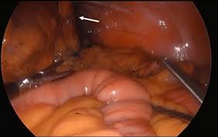

Slide 25
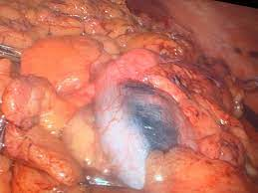

Slide 26
Thanks for your attention

